Slide 1
Introduction to Deep Learning
Neural Networks

Slide 2
Before Starting the Course
Upon completion of this course, you will have acquired general knowledge of introductory artificial intelligence algorithms and data analysis
Since the specific topics are difficult to understand and it will not be easy for the one to settle the logic during the lesson, a lot of individual practice is required
Slides will be explained with visuals without drowning in texts. That is why it is extremely important to take notes during the lesson
Since the titles are sufficient for basic level algorithms, the titles should be researched, and research should be done on sites that contain plenty of practice and theoretical information

Slide 3
What You Will Learn In This Training
We will make an in-depth introduction to artificial neural networks and get to know neurons, which are the cornerstones of artificial neural networks
We will see the steps that take place during the training of a Deep Learning model and give the concepts of Artificial Neural Networks Mathematics to understand what happens during a training
We will learn how the activation function, optimizer and hyper-parameters that we will see in the working steps of the artificial neural network work and we will see the commonly used types
We will meet Perceptron, the basic unit of single-layer artificial neural networks, and we will code Perceptron

Slide 4
Mert Çobanov
Github: cobanov
Linkedin: mertcobanoglu
Twitter: mertcobanov

Slide 5

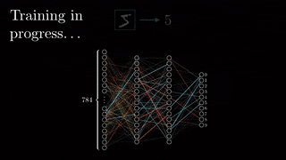
Artificial Neural Networks
Neural networks are information processing systems with interconnected neurons. Using certain algorithms they can recognize, cluster, and classify hidden patterns and correlations in raw data and continually learn and improve – over time.

Slide 6
Artificial Neural Networks
Artificial Neural Networks consist of 3 layers:
Input layer: It is the layer where we feed the data to our model. Always accepts vector data.
Hidden layer: Each layer between the input and output layer. This layer contains neurons with activation functions to ensure non-linearity.
Output layer: It is the layer where the output of our model is given. Produces the appropriate output for the selected activation function according to the type of problem.

Slide 7
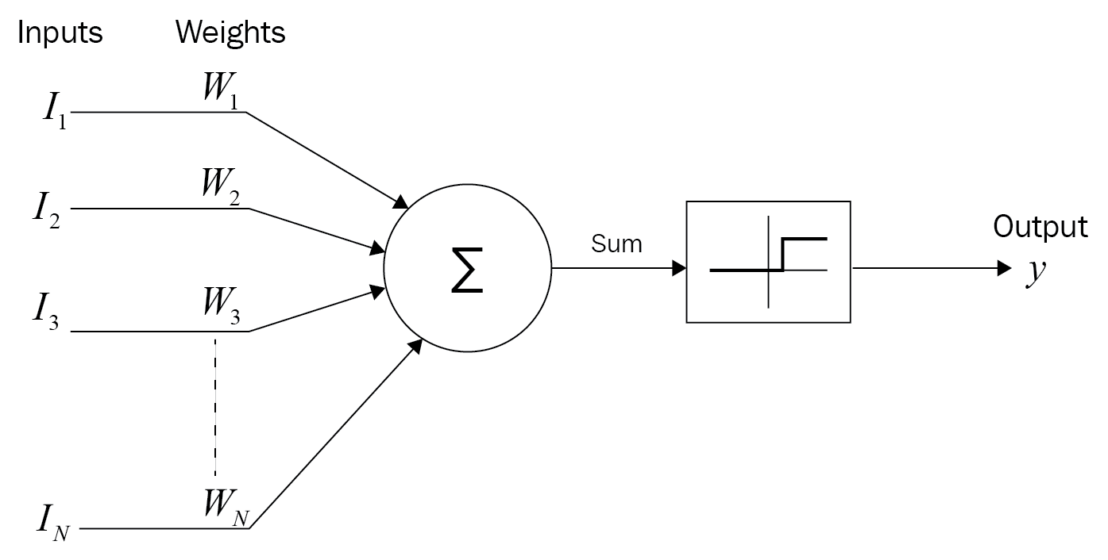
Neuron Concept

Slide 8
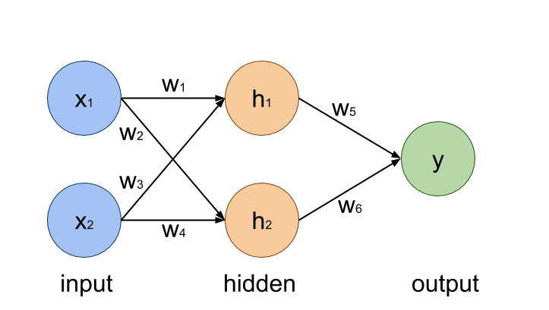
Neuron Concept
Neurons are nodes in the network through which data and computations flow. The Input, Hidden and Output layers consist of neurons.
The neurons in the hidden layer contain an activation function, and these activation functions saves the neural network from linear dependence.
This process plays an active role in solving more complex problems than classification or regression problems.

Slide 9
Fundamental Regression Math

Slide 10
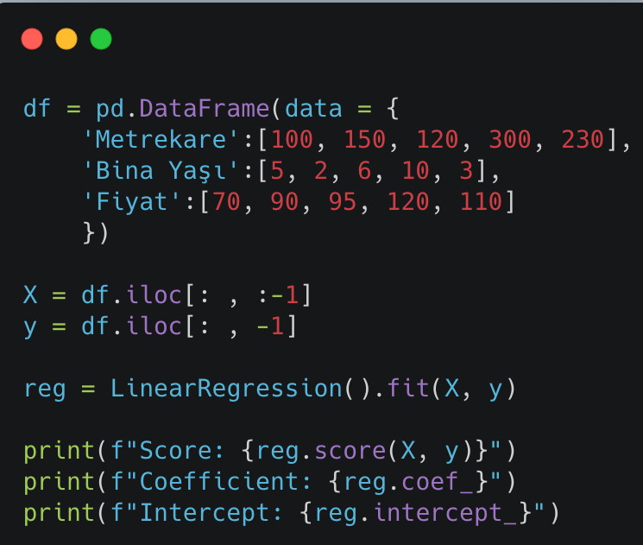
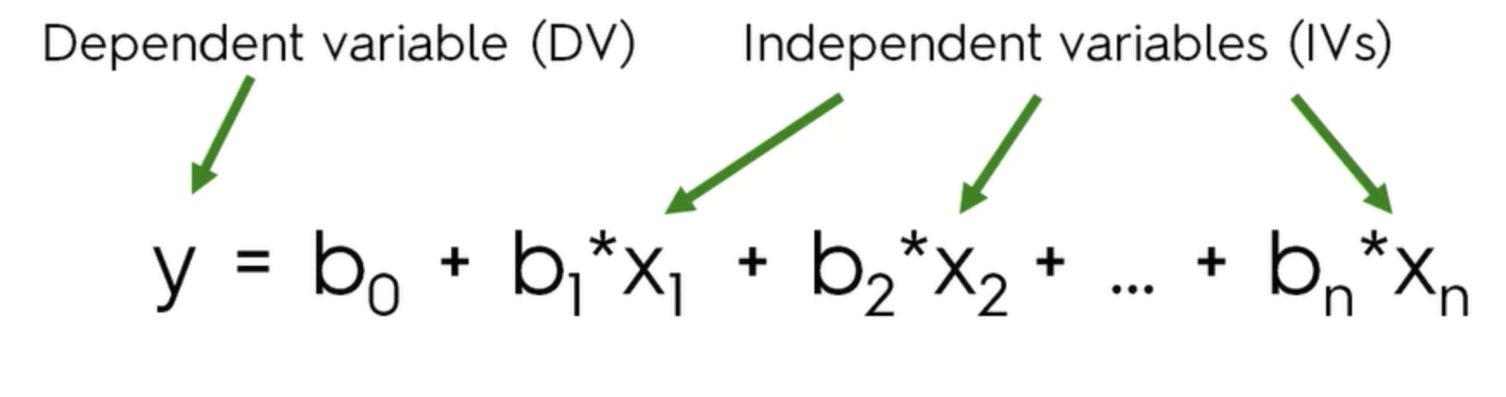
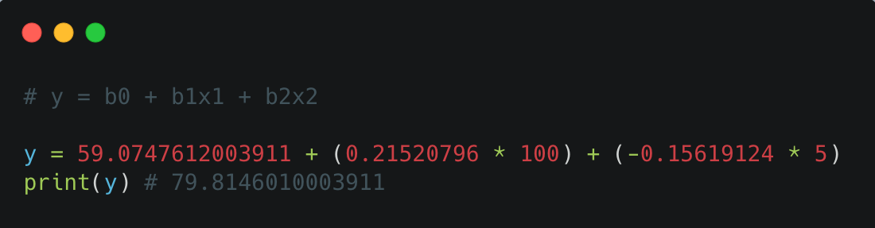
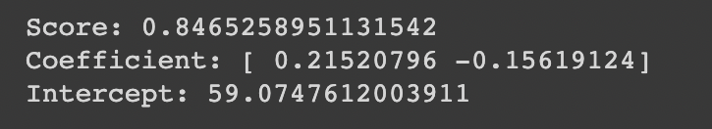
Linear Regression Math
Linear Regression establishes a relationship between a dependent variable (y) and one or more independent variables (x).

Slide 11
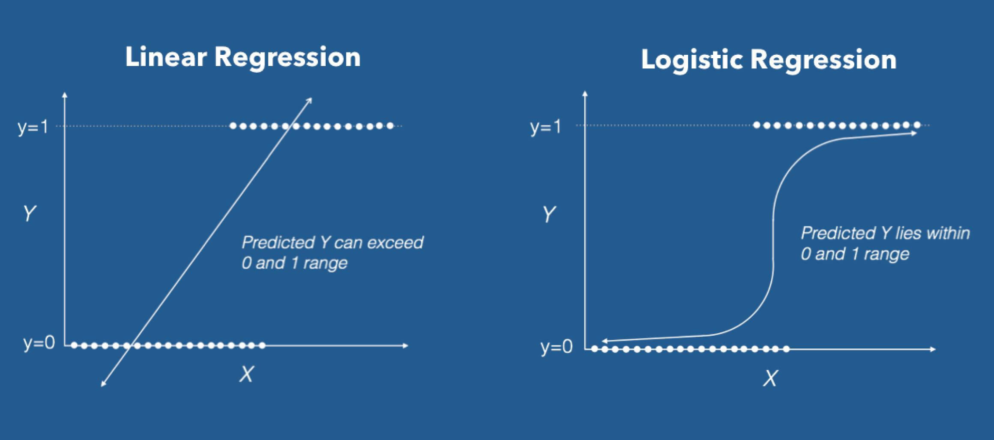
Logistic Regression Math
Logistic Regression is a form of regression where the dependent variable is a categorical variable. With this function, binary classification problems can be solved.

Slide 12

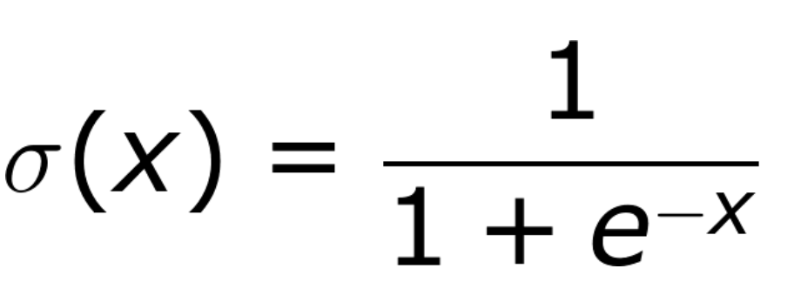
Sigmoid Activation Function
The sigmoid function is an activation function that extracts a probability value by compressing a continuous value between 0 and 1.
It has an S-shaped curve
Compresses the value between 0 and 1
Sigmoid Function is used in logistic regression problem

Slide 13
Components and Mathematics of Artificial Neural Networks

Slide 14
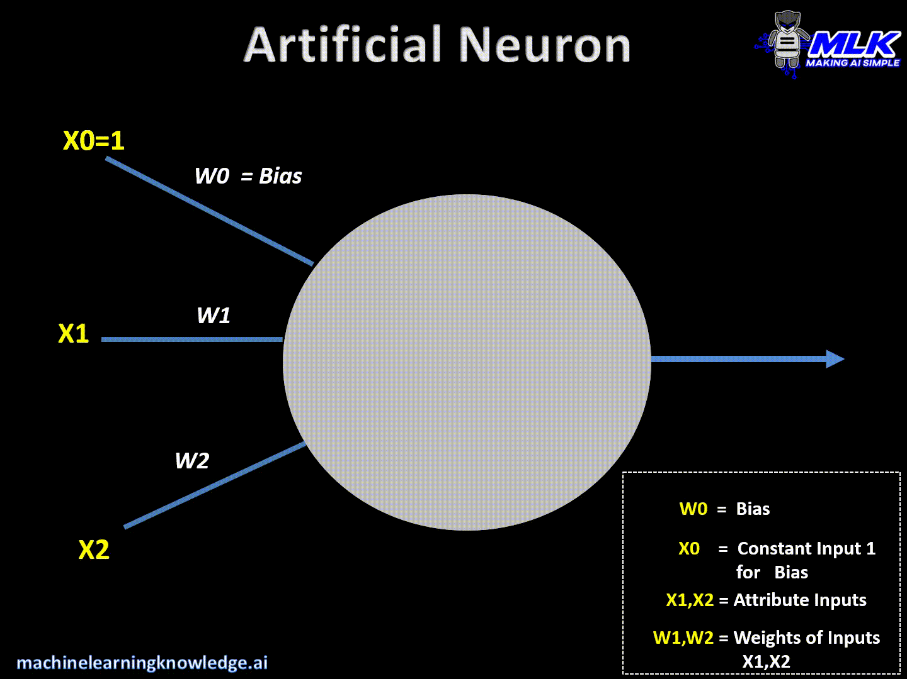
Weight
In basic machine learning, weight is a feature coefficient that indicates how much an independent variable affects the dependent variable.
In Artificial Neural Networks, the weight is the coefficients of each neuron value.
Neurons that connecting to a neuron are multiplied by their own weight.
y = wo * x0 + w1 * x1+w2 * x2

Slide 15
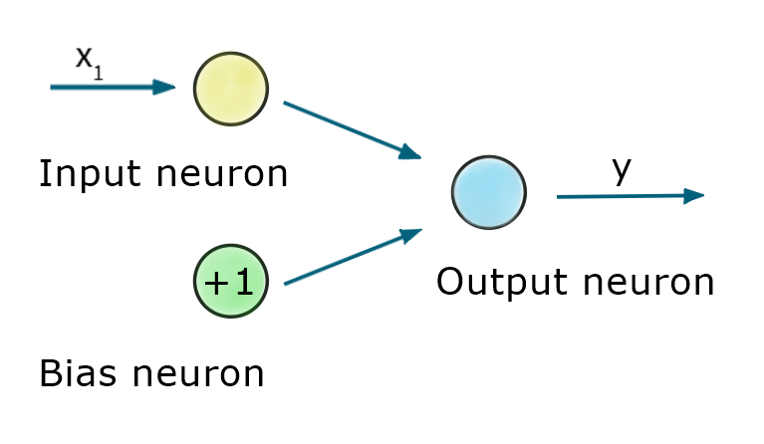
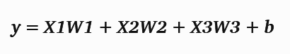
Bias
Bias allows the activation function to be shifted left or right to better fit the data.
Bias is also a threshold that determines whether the output of a neuron is transmitted to the next layer. If the output of our neuron cannot exceed a certain threshold value (bias), the output is not transmitted to the next layer.
All neurons connected to a neuron in the network are multiplied by their own weights. In the following example, an equation is obtained as follows:
If there was no bias, an equation would appear like this:

Slide 16
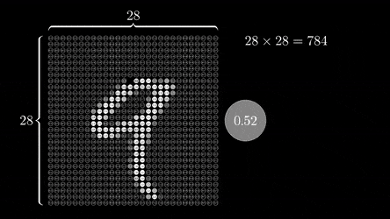
Input
In an artificial neural network, the shape of the input data and the shape of the input layer of the artificial neural network must be the same. This layer is where the data enters the network.
The input layer of the Neural Network accepts the data as vectors and if the data has more dimensions than rank 1 tensor, it should be reduced to rank 1 tensor using data reshape. For example, to export your 28x28 data to your neural network, you must convert it to a vector with 784 elements.

Slide 17
Output
The output layer is responsible for producing the final result. A neural network should always have an output layer.
The desired output is obtained through the activation function that determined in the output layer according to the type of problem.

Slide 18

Simple Perceptron Coding

Slide 19
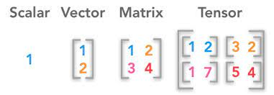
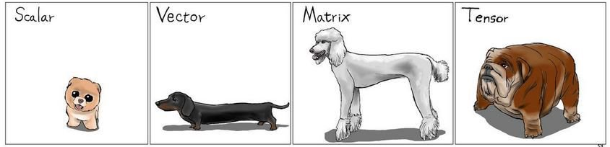
Data Types & Tensors
The data fed into neural networks can be described by the data types in linear algebra.
Scalar: Data with singular value. Scalar value is also Rank 0 Tensor.
Vector: It is one-dimensional collection data. Vector is also Rank 1 Tensor.
Matrix: It is two-dimensional collection data. The Matrix is also a Rank 2 Tensor.
Tensor: It is more than two dimensional collection data. They are tensors with more than 2 different rank.

Slide 20
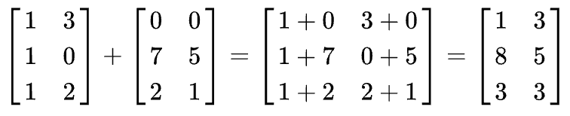
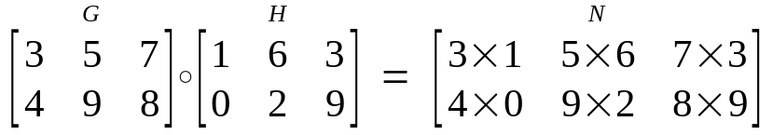
Algebra Operations in Matrices
Addition Operation: When two matrices are added, a new matrix is obtained by adding the spatially corresponding values. In order to add the matrices with each other, they must be of the same size, and the sum matrix is the same size as the summed matrices.
Element-wise Product (Hadamard Product): Hadamard multiplication of matrices is an element-wise operation. The spatially corresponding values are multiplied to produce a new matrix.

Slide 21
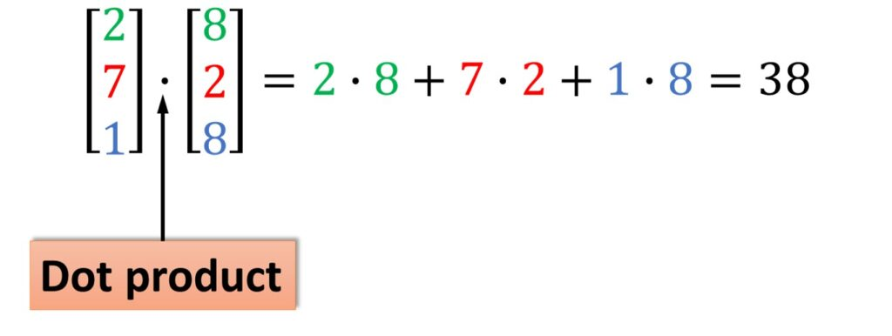
Algebra Operations in Matrices
Dot product: When this operation is applied to vectors, the result is scalar. E.g:
In order to apply this operation to matrices, the dimensions of the matrix should be mxn and nxm, respectively. The output tensor will be mxm in size.

Slide 22
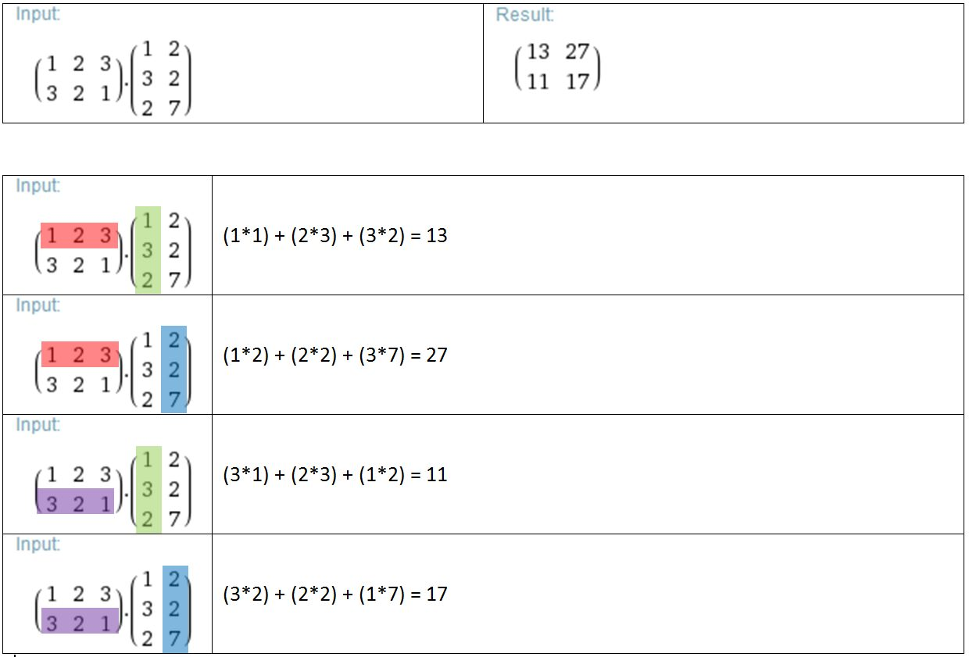
Algebra Operations in Matrices
Dot product: The matrices are divided into vectors and the vectors are multiplied to get a scalar value. In the vectorization process, the rows of the first matrix of mxn size and the columns of the second matrix of nxm size are taken as vectors, and the matrix with the size of mxm is formed with the multiplication results.

Slide 23
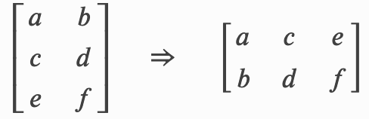
Algebra Operations in Matrices
Transpose Operation: This operation allows us to reverse the dimensions of the matrix. Converts a mxn matrix to nxm size. In Deep Learning, the input of our model can be a tensor of any rank, and these tensors may not be suitable for algebra operations in size. Transpose aims to provide this fit but does not always guarantee this fit, you may need to convert your matrix to a more customized size.

Slide 24
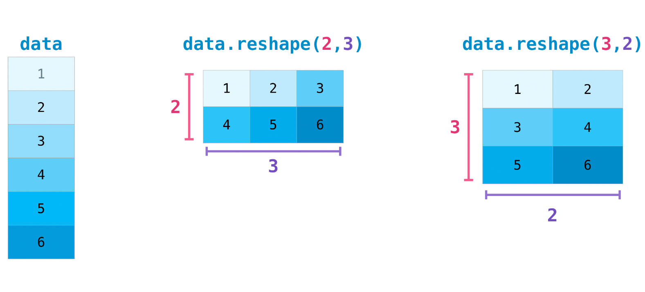
Algebra Operations in Matrices
The size of the tensor can be changed with the reshape() operation in Numpy. The point to be considered during this process is that your new dimension can hold as many elements as the old dimension.
For example, a 6x4 matrix will hold 24 elements. You can convert this size to 12x2 as this will also hold 24 elements. But you cannot convert the size of a 24-element tensor to 5x3. Because a 5x3 tensor holds 15 elements.

Slide 25
How Does Neural Network Work?

Slide 26
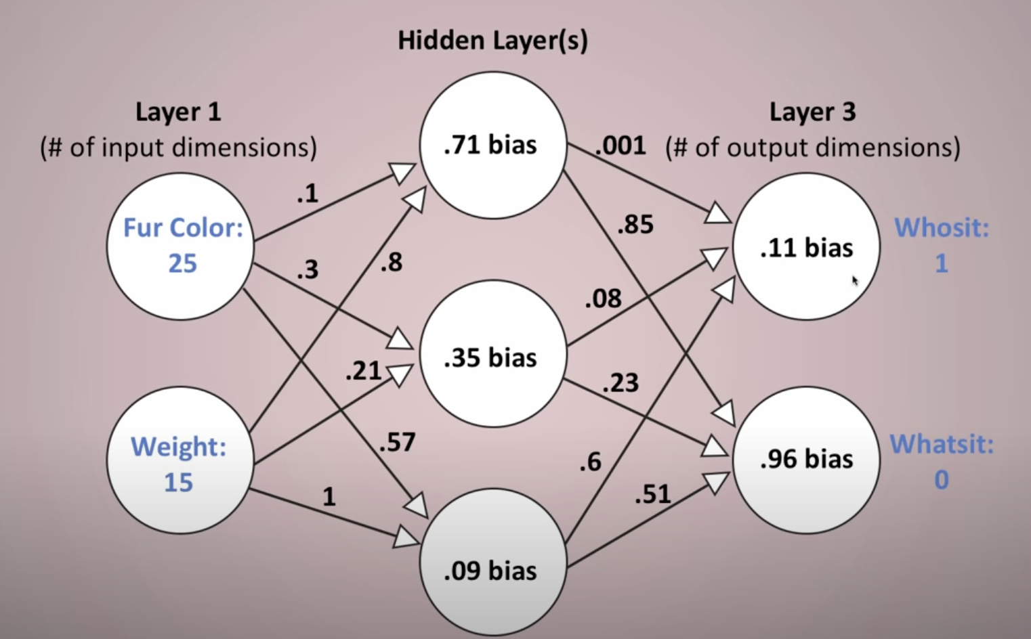
How Does Neural Network Work?
Forward Propagation:
Our input data is given to artificial neural networks. The weight values in our artificial neural network in our neurons are given randomly.
The data in the input neuron is sent to the next neuron with the weight values.
Each neuron multiplies and sums the values and weights of the neurons connected to it. This result is being given as input into the activation function.

Slide 27
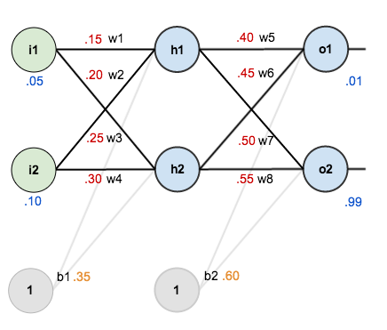
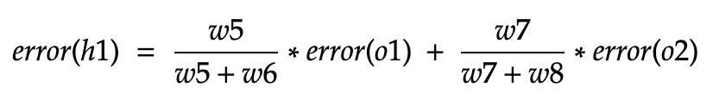
How Does Neural Network Work?
Back Propagation:
The prediction results from the neurons in the output layer are compared with the real value and the error is calculated. Using these error values and the weight values of the previous layer, the error of the previous layer is calculated.
Gradients are calculated using the calculated error values. Weight values are recalculated using these gradients.
The error formula is given based on the network in the figure.

Slide 28
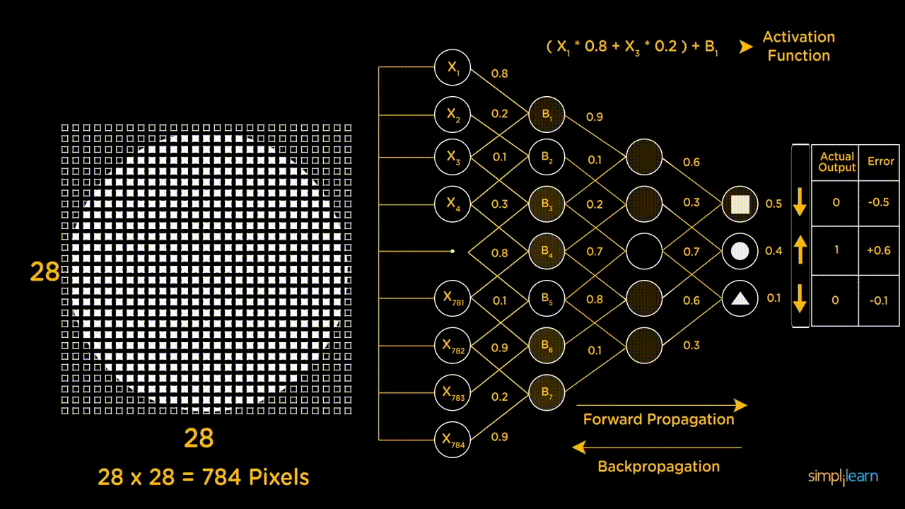
Yapay Sinir Ağları Nasıl Çalışır?

Slide 29
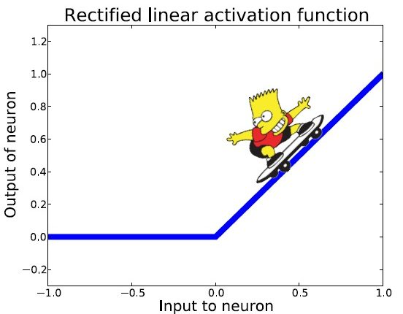
Vanishing Gradient Problem
As more layers are added to neural networks that use certain activation functions, the gradients of the loss function approach zero and the network becomes harder to train.
Gradients of neural networks are found using back propagation. It finds the derivatives of the network by moving layer by layer from the last layer to the first layer. According to the Chain Rule, the derivatives of each layer are multiplied in the network (from the last layer to the first layer) to calculate the derivatives of the first layers.

Slide 30
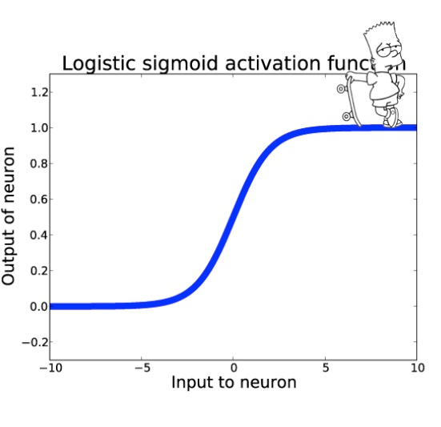
Vanishing Gradient Problem
The sigmoid function compresses the output between 0 and 1. Therefore, a large change in the input of the sigmoid function causes a small change in the output. So the derivative is small.
When using an activation such as the sigmoid function with n hidden layers, n small derivatives are multiplied together. Thus, the gradient decreases exponentially as it moves towards the initial layers during back propagation.
One possible solution to the Vanishing Gradient problem is to use the ReLU activation function, which does not produce a small derivative like the sigmoid function.

Slide 31
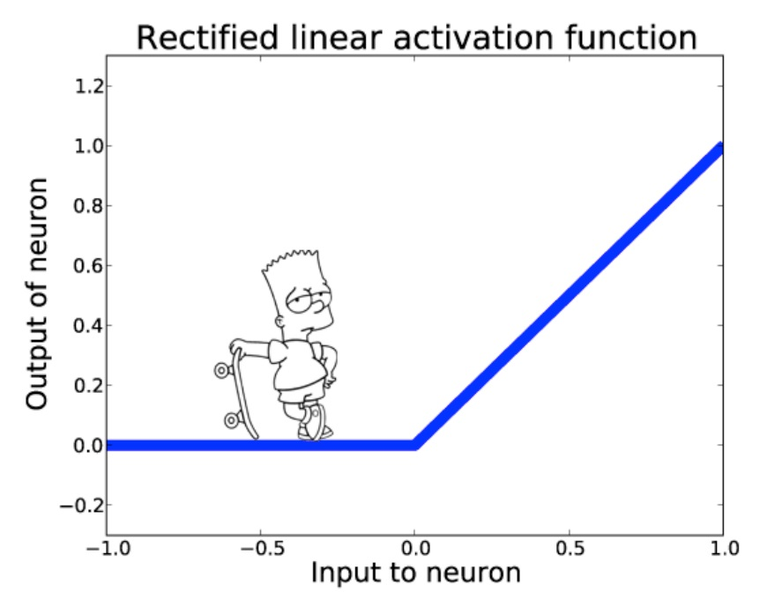
Dying ReLU Problem
Although ReLU solves the Vanishing Gradient problem, it causes another problem; Dying ReLU.
The gradient is 0 for negative values because ReLU equalizes negative inputs to zero.
If there are many neurons in the network that produce 0 outputs, learning will not take place as it should.
Although this characteristic is what gives ReLU its power, it will cause problems if there are too many negative inputs.

Slide 32
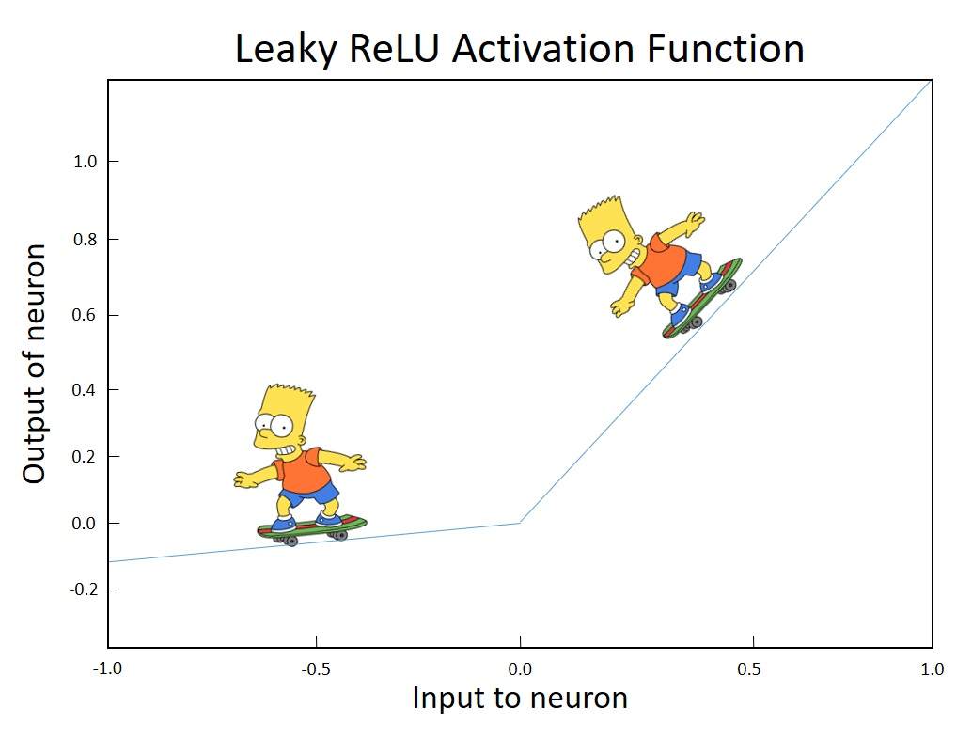
Dying ReLU Problem
The problem with Dying ReLU is that the weights cannot be updated during back propagation when most of the neurons are reset due to negative input.
In this case where ReLU is insufficient, Leaky ReLU can be used.
Leaky ReLU is an activation function that does not produce a value of 0 for negative inputs.
In scenarios where there are many negative inputs, since these inputs can also be derived, the back propagation operation will be able to update the weights.

Slide 33
Dying ReLU Problem
The Dying ReLU problem does not always occur, as the optimizers consider multiple input values at a time.
As long as all inputs do not push the ReLU into the negative segment, the neurons can remain active, the weights can be updated, and the network can continue learning.

Slide 34
Activation
Functions

Slide 35
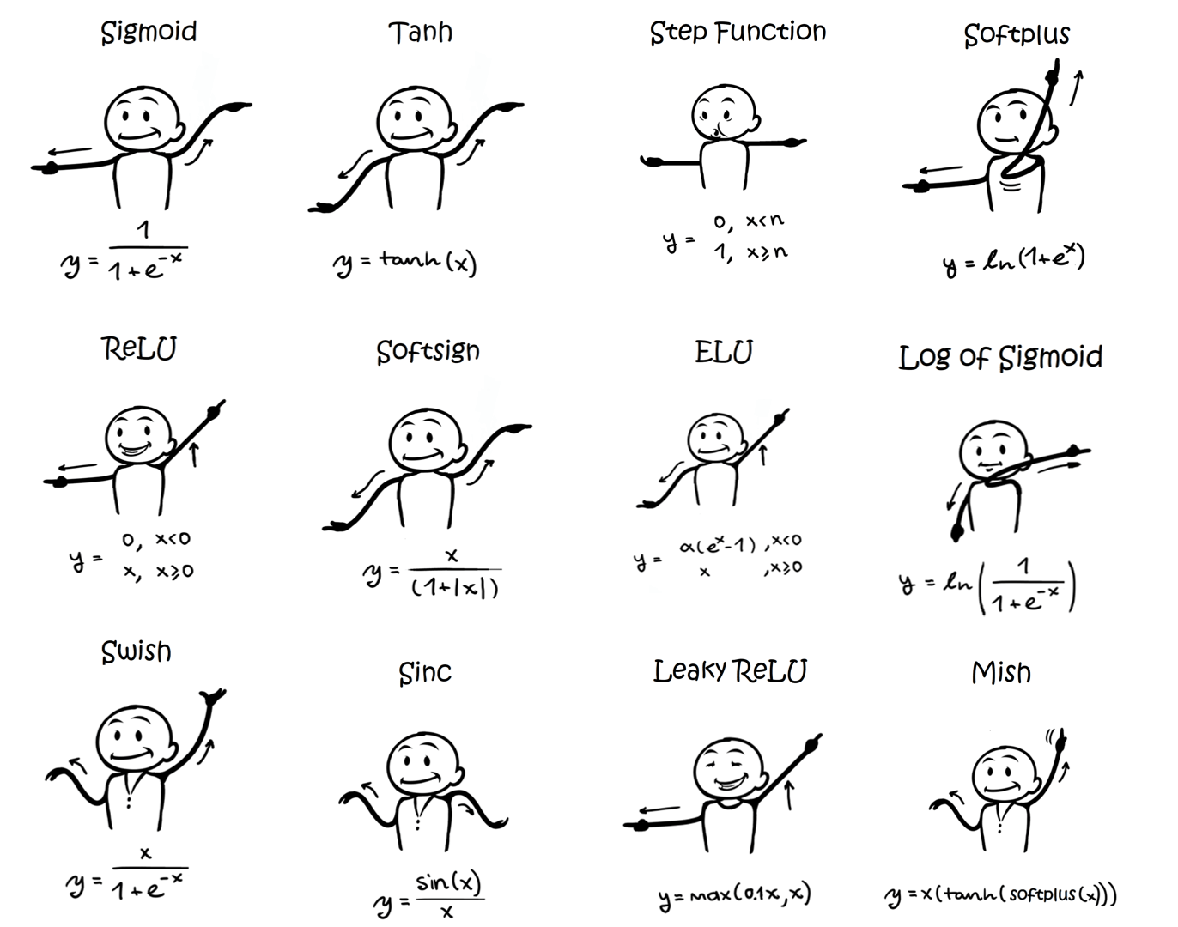
What is Activation Function?
The activation function, in its simplest form, is the function that decides how a linear function calculated using the inputs of a neuron will exit the neuron.
It is used to distort the linearity and determines how the linearity will be distorted.
A classical neuron does not have an activation function unless given manually and performs a linear computation.

Slide 36
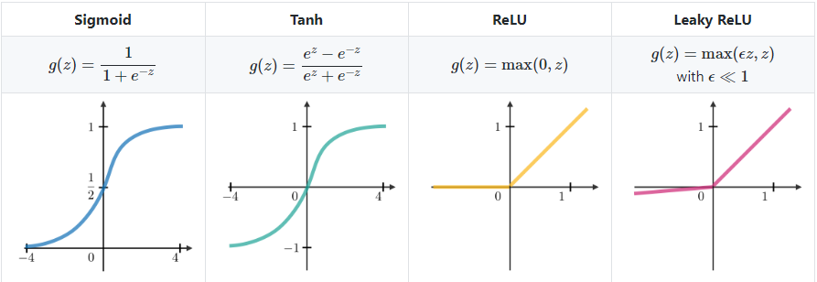
Why Use the Activation Functions?
Layers added to our artificial neural network without the activation function do not increase the strength of the network. In other words, if the layers in our model produce linear outputs, the added layers do not expand the hypothesis space benefiting from deep representations and features are not learned.
The concept presented by the artificial neural network is that the neurons in each hidden layer, with the help of the activation function, disrupt the linearity of the input data as a result of certain mathematical operations.

Slide 37
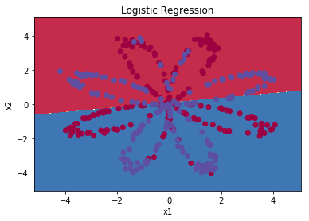
Why Use the Activation Functions?
When the logistic regression model was created for the example on the right, the accuracy value of the model was 47%. (As the data distribution is equal, the accuracy metric is used)
Looking at the example, it can easily be seen that the distinction between the two classes cannot be separated by a linear line.
By solving this type of problem with an artificial neural network, the required non-linearity can be provided by the activation functions in the hidden layers.

Slide 38
Commonly Used Activation Functions

Slide 39
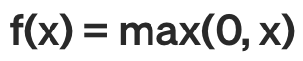
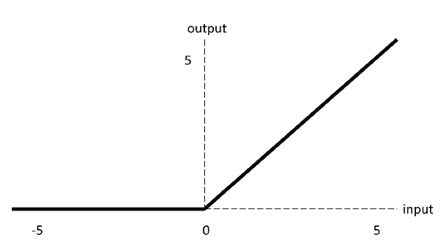
ReLU (Rectified Linear Unit)
ReLU is an activation function that returns 0 for negative values and the value itself for positive values.
ReLU includes simpler mathematical operations compared to tanh and sigmoid, thus further improving computational performance.
ReLU is used as a solution to the Vanishing Gradient problem as it does not produce small outputs.

Slide 40
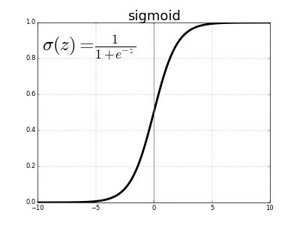
Sigmoid Function
It is a non-linear function. The value range of this function, which has a probabilistic approach to decision making, is between [0,1].
Changes in the x value in these functions will cause serious changes on the y value
No matter how much x changes between (-infinity, +infinity) the activation value will always be between 0 and 1

Slide 41
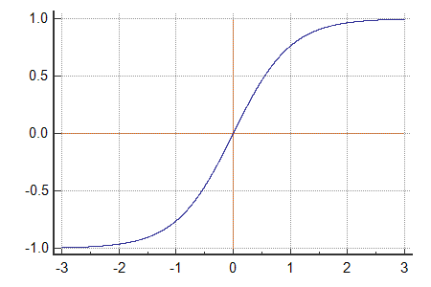
Tanh Function (Hyberbolic Tangent)
Although it is characteristically similar to the Sigmoid function, the output is centered at 0 and the limits are -1 and 1.
The Tanh function is a scaled Sigmoid function and converges faster than a Sigmoid function.
Although the output bounds have expanded relative to Sigmoid, it continues to get stuck in the Vanishing Gradient problem.

Slide 42
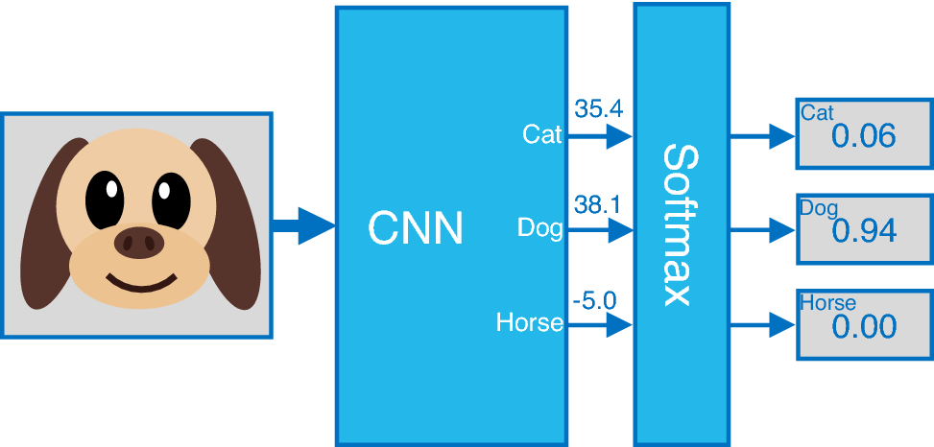
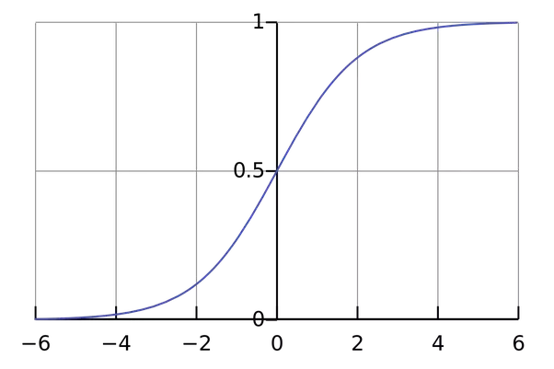
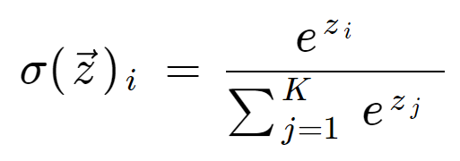
Softmax Function
Softmax returns a probability result for each class as output in a multi-class classification problem.
For multi-class operations your network should end with a softmax activation function so it will give a probability distribution over N output classes.

Slide 43
Optimization of Neural Networks

Slide 44
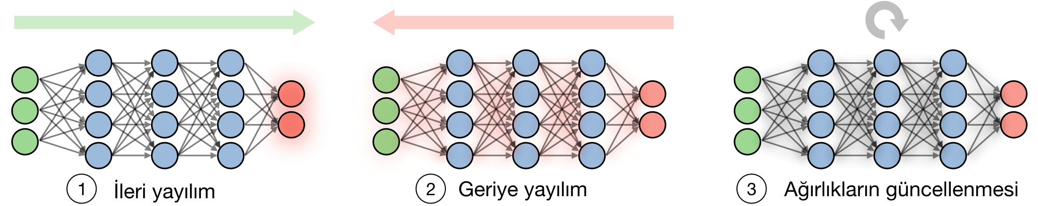
Backpropagation
Back propagation is a method used to update the weights in the neural network taking into account the desired output. The derivative for each weight is calculated using the chain rule.
• Step 1: Get a set of training data and move forward to calculate the loss
• Step 2: Broadcast the loss backwards again to get the degree of loss for each weight
• Step 3: Use gradients to update the weights of the mesh

Slide 45
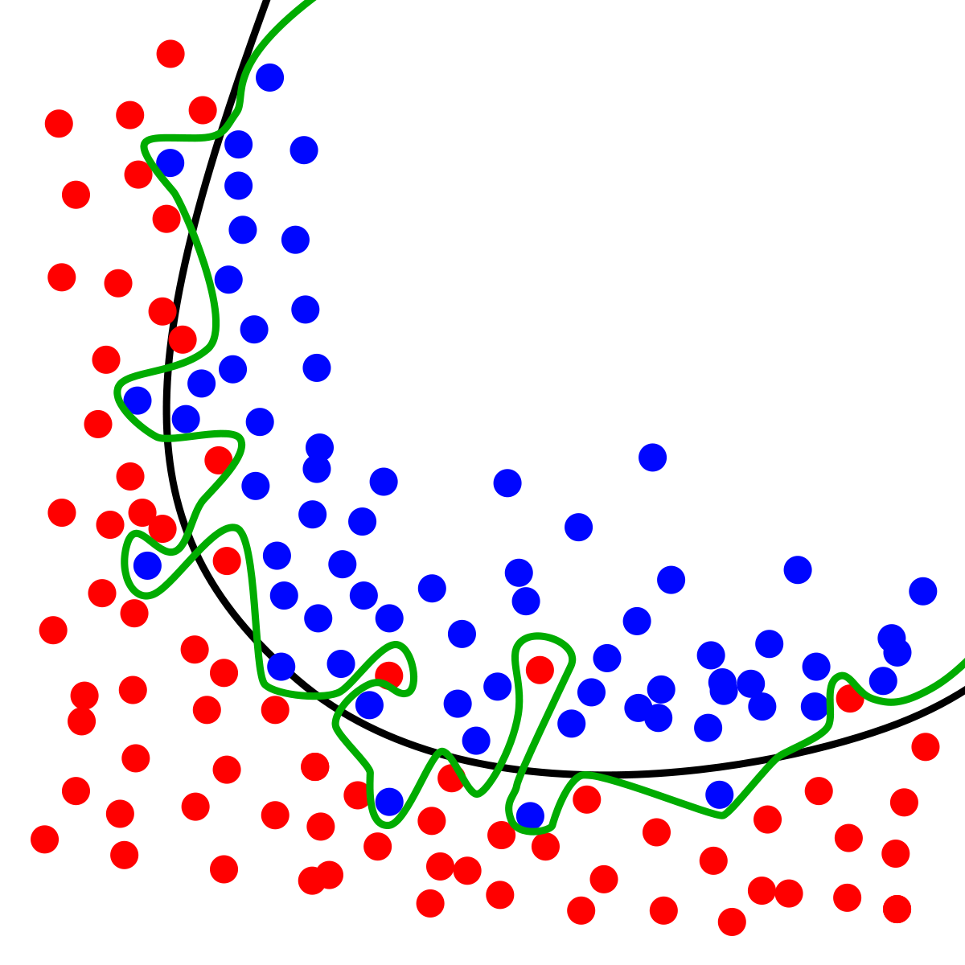
Overfitting
It is a situation that occurs when the algorithm memorizes the training data along with its results. Situations that may cause excessive learning;
High epoch value and long training time
Using too many variables
In case of overfitting, the model also recognizes the noise in the data and searches for the noise in the test data, reducing the accuracy.
When overfitting occurs, the algorithm cannot work efficiently against the data it sees for the first time.

Slide 46
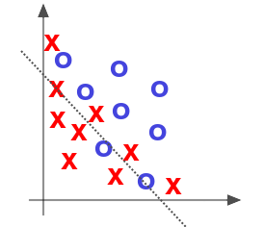
Underfitting
The algorithm does not adequately fit the training data and has trouble generalizing the data. In order not to experience underfitting;
Increase our training data
Add more variables
Decrease the Regularization value to increase the variable weight
When underfitting occurs, the training and test dataset has a high error rate, low variance, and high bias.

Slide 47
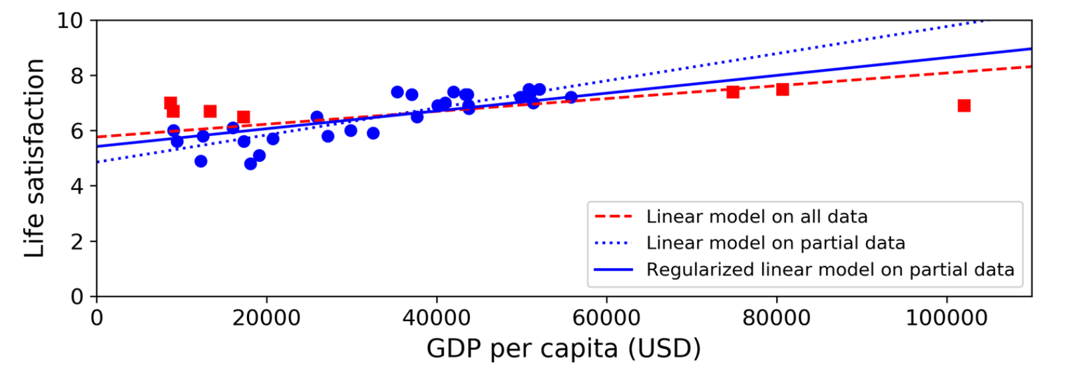
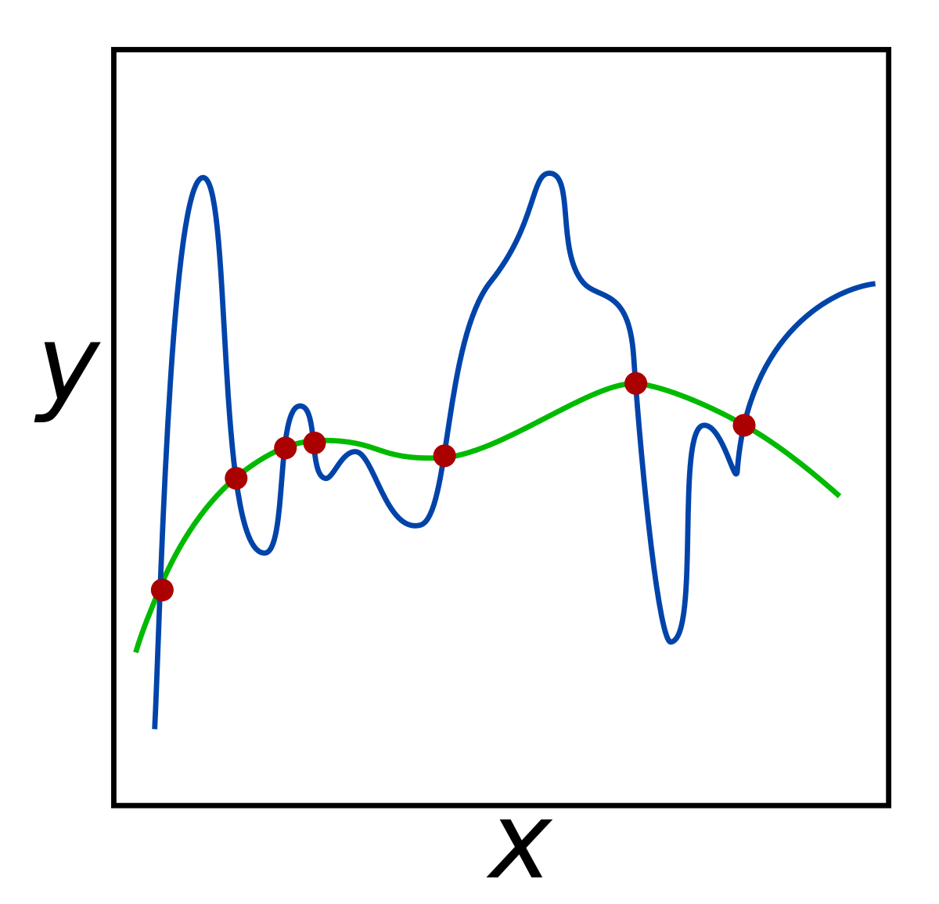
Regularization
Regularization is the process of constraining a model to simplify and prevent overfitting. This improves the model's performance on unseen data. In this method, the weights in the cost function are updated by adding another term known as the regularization term, which penalizes them.
The amount of regularization to be applied during learning can be controlled by a hyper parameter called regularization term (or regularization parameter).

Slide 48
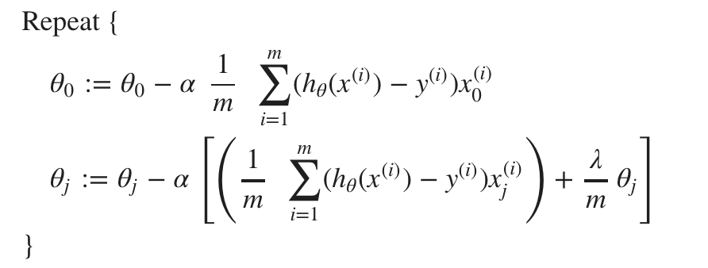

Regülarizasyon
L1 Lasso
In L1 regularization the error function is penalized by the absolute value of the weights
The derivative of L1 is k (a constant whose value is independent of weight)
It is a force that subtracts the derivative of L1 from the weight some constant each time.
L2 Ridge
In L2 regularization, the error function is penalized by the square of the weights.
The derivative of L2 is 2 * weight
It is a force that removes x% of the weight each time the derivative of L2

Slide 49
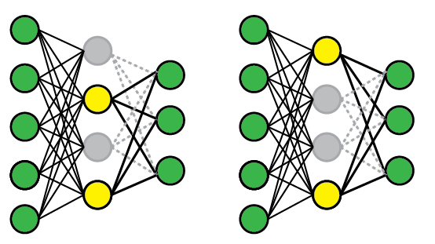
Dropout
Dropout refers to data or noise intentionally dropped from a neural network to improve processing and time to results. In other words, it’s a technique where randomly selected neurons are ignored during training.
Randomly selected neurons’ contribution to the network is temporally removed on the forward propagation and any weight updates are not applied to the neuron on the backward propagation.

Slide 50
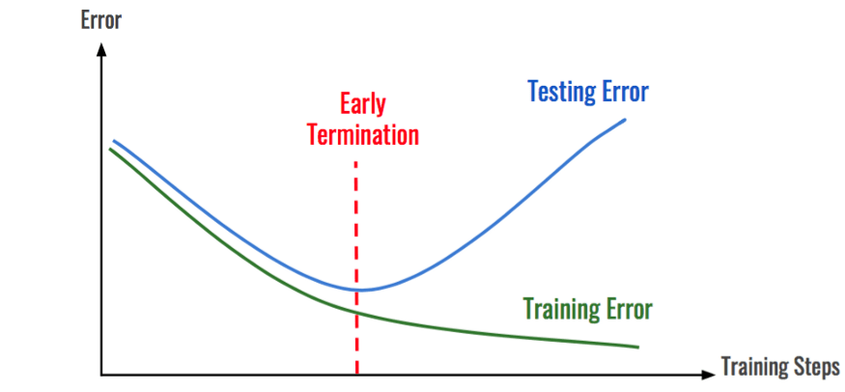
Early Stopping
A very different way to regularize iterative learning algorithms like Gradient Descent is to stop training as soon as the validation error reaches a minimum.
A simple and effective editing technique called the No Free Lunch Theorem by Geoffrey Hinton, winner of the 2018 Turing Award with Yoshua Bengio and Yann LeCun
A minimum error value is determined and n more iterations occur when the validation set error falls below or equals this limit. If our performance does not improve, our error value returns to the best point and training stops.

Slide 51

Data Augmentation
Data augmentation in data analysis is a technique used to increase the amount of data by adding slightly modified copies of existing data or newly created synthetic data from existing data.
It helps avoid overfitting when training a machine learning model.
It is closely related to oversampling in data analysis.

Slide 52
Optimizer

Slide 53
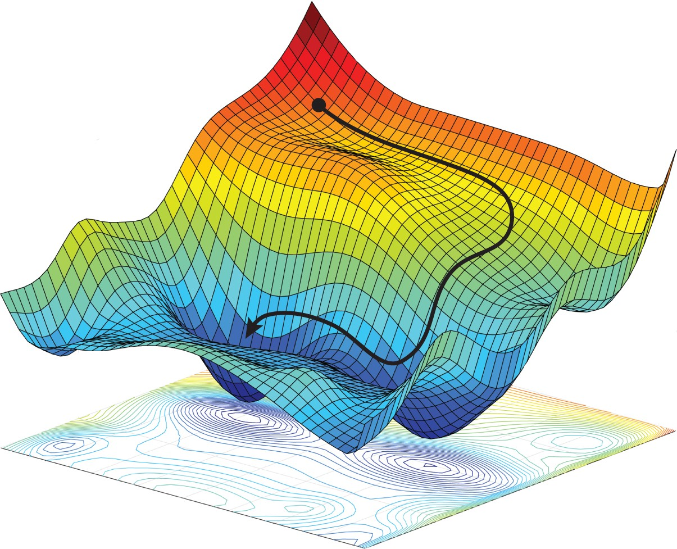
What is Optimizer?
Optimizers are methods used to minimize an error function (loss function) and maximize model’s accuracy.
Optimizers are mathematical functions that depend on the learnable parameters (Weights & Biases) of the model.
Optimizers help to know how the weights of the neural network will change to reduce losses.

Slide 54
Common Optimization Algorithms

Slide 55
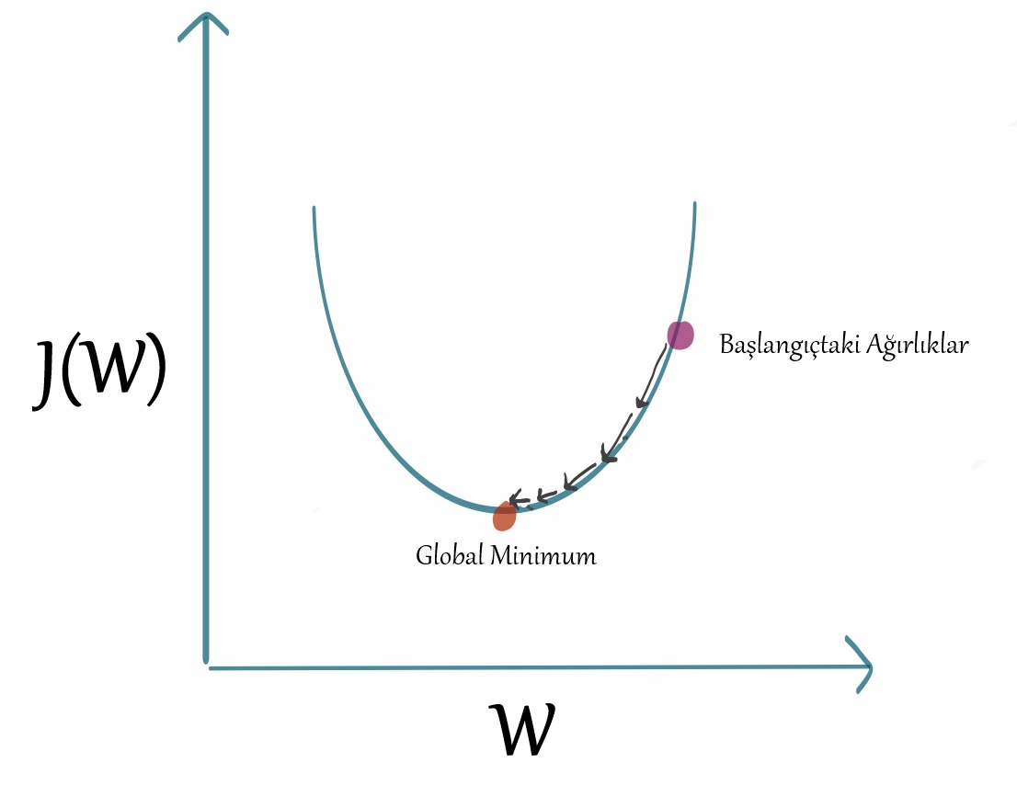
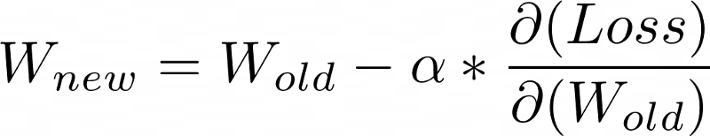
Gradient Descent
Gradient descent is an optimization algorithm based on a convex function and iteratively adjusts its parameters to minimize a given function to the local minimum.
Because this method calculates the gradient for the entire dataset in a single update, the computation is very slow and expensive. Therefore, it requires large memory.

Slide 56

Stochastic Gradient Descent
Stochastic gradient Descent (SGD), a variation of the Gradient Descent algorithm, performs a parameter update for each training sample.
Requires less memory, constantly updating model parameters, and being more suitable for use with large data sets are advantages compared to Gradient Descent Algorithm.
If the model has 10K datasets, SGD will update the model parameters 10K times since this update will be done for each training sample seperately.

Slide 57

RMS-Prop (Root Mean Square Propagation)
RMSprop is a gradient-based optimization technique used in training neural networks.
Instead of treating the learning rate as a hyperparameter, RMSprop uses an adaptive learning rate. This means that the learning rate changes over time.

Slide 58

Adam (Adaptive Moment Estimation)
Adam is an adaptive learning rate method i.e. it calculates adaptive learning rates for each parameter.
The name Adam optimizer is derived from adaptive moment estimation, and it is so named because Adam uses estimates of the first and second gradient moments to adapt the learning rate for each weight of the neural network.

Slide 59
Hyper-Parameters in Artificial Neural Network

Slide 60

Epoch
It is the number of times that all the data passed through the model for training.
It aims to iterate through the training steps to update the weights of the model, using the entire training set.
The weights are updated with each epoch. It is tried to decrease the loss value and increase the accuracy value. These operations are done with the specified optimizer and loss function.
An example of the concept of epoch is the number of times a student preparing for the university exam completes the question bank from start to finish, closing some of his deficiencies and trying to increase the accuracy at each completion. It will solve the question bank as many times as it has aimed from the beginning.

Slide 61
Batch Size
When the number of our data is large, training at once leads to higher processing costs in memory and thus loss of performance.
The batch size hyper-parameter defines the number of data to be propagated over the network at one time. Training takes place by transferring your data to your memory until the batch size, and the epoch is not complete until all your data is transferred to your memory.
An example of the Batch Size parameter is how many pages a student preparing for the university exam will divide the book into and how many pages will be studied at the same time in order to complete the question bank from start to finish.

Slide 62
Question Time

